Slide 1
Exploring Automated 3D Segmentation and Visualization for Post-Treatment Gliomas
Rc4 irtp – 3D computer vision school
Eugene kim (02217059)
Challenges, Insights, and Future Directions from the BraTS 2024 Adult Glioma Post Treatment Challenge
1/38

Slide 2
Overview
Introduction:
Gliomas, mpMRI, importance of automated segmentation.
BraTS 2024 Challenge:
Dataset overview and challenge description.
Dataset Preprocessing & Description:
Data preprocessing steps and dataset structure.
3D U-Net Approach:
Modifications for post-treatment gliomas and model adjustments.
First Winner’s Approach:
Overview of the first winner’s solution.

Slide 3
overview
Results & Visualization:
Segmentation results and visualizations.
Challenges:
Technical, computational, and data-related obstacles.
Future Work:
Model comparison and improvements.

Slide 4
introduction

Slide 5
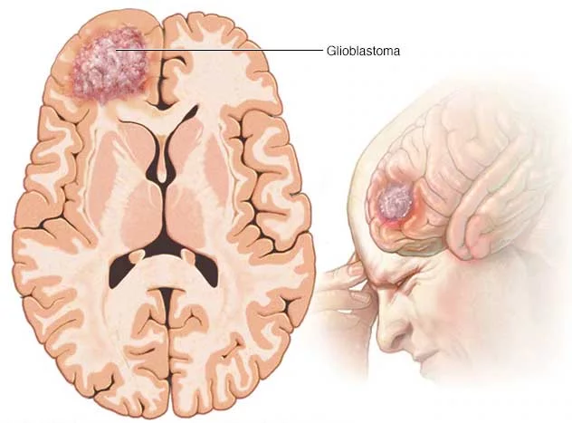
Background: gliomas & their treatment
Gliomas:
aggressive brain tumors originating from glial cells
Prognosis remains poor for high-grade (fast-growing) gliomas.
Treatment:
Surgery (to remove the tumor)
Radiation & Chemotherapy (to eliminate any remaining cancer cells)

Slide 6
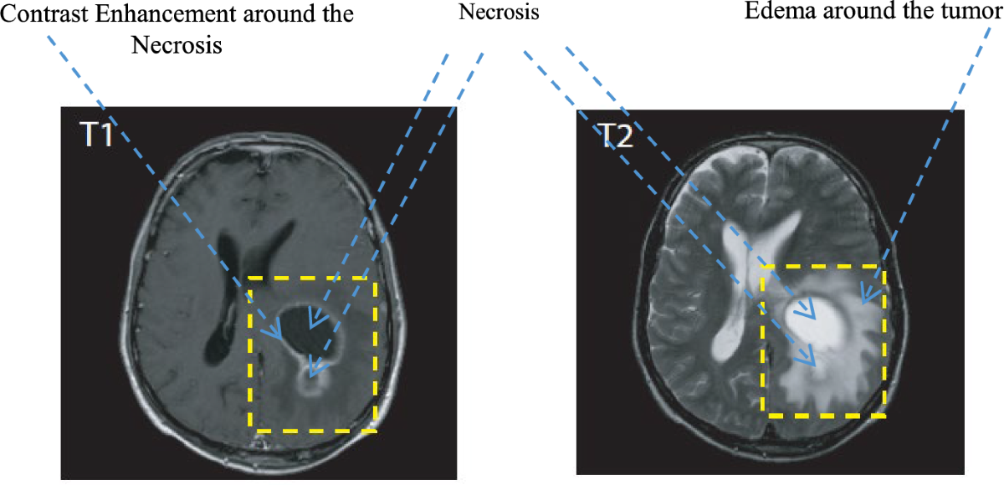
Post-treatment challenges in glioma monitoring
MRI scans:
essential for monitoring post-treatment gliomas
Challenges:
Difficulties in distinguishing between tumor recurrence & treatment effects (like necrosis)
The need for consistent & automated segmentation techniques

Slide 7
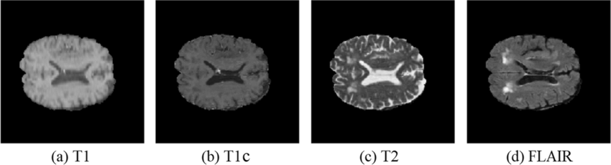
Role of MRI in post-treatment gliomas
MRI provides detailed information about glioma regions.
Multiparametric MRI (mpMRI):
Combines multiple MRI sequences for better diagnosis
Helps differentiate tumor recurrence vs. treatment-related changes
Requires multi-modal fusion for effective tumor delineation.

Slide 8
Role of MRI in post-treatment gliomas
T1-weighted (T1 or T1n):
Anatomical detail.
T1-contrast (T1Gd or T1c):
Highlights enhancing tumor regions.
T2-weighted (T2 or T2w):
Detects fluid and edema.
FLAIR (T2f):
Differentiates abnormal tissue from cerebrospinal fluid.

Slide 9
Importance of Automated Segmentation
Manual
Segmentation
Time-Consuming:
Automated
Segmentation
Faster & More Efficient:
AI-based models can segment in seconds.
Consistency:
No human bias; reproducible results.
Scalability:
Can process large datasets.
Aids Clinical Decision-Making:
Helps radiologists analyze results more efficiently.
Can take hours per scan.
Inter-Observer Variability:
Different radiologists may label tumors differently.
Subjective & Prone to Error:
Hard to consistently differentiate tumor from post-treatment changes.
Limits Large-Scale Studies:
Not feasible for analyzing thousands of scans.

Slide 10
Clinical significance of automated segmentation in post-treatment gliomas
Helps monitor tumor progression across different timepoints.
Assists in differentiating tumor recurrence from treatment effects (e.g., radiation necrosis vs. actual tumor regrowth).
Enables quantitative analysis for personalized treatment strategies.

Slide 11
BraTS 2024 challenge overview

Slide 12
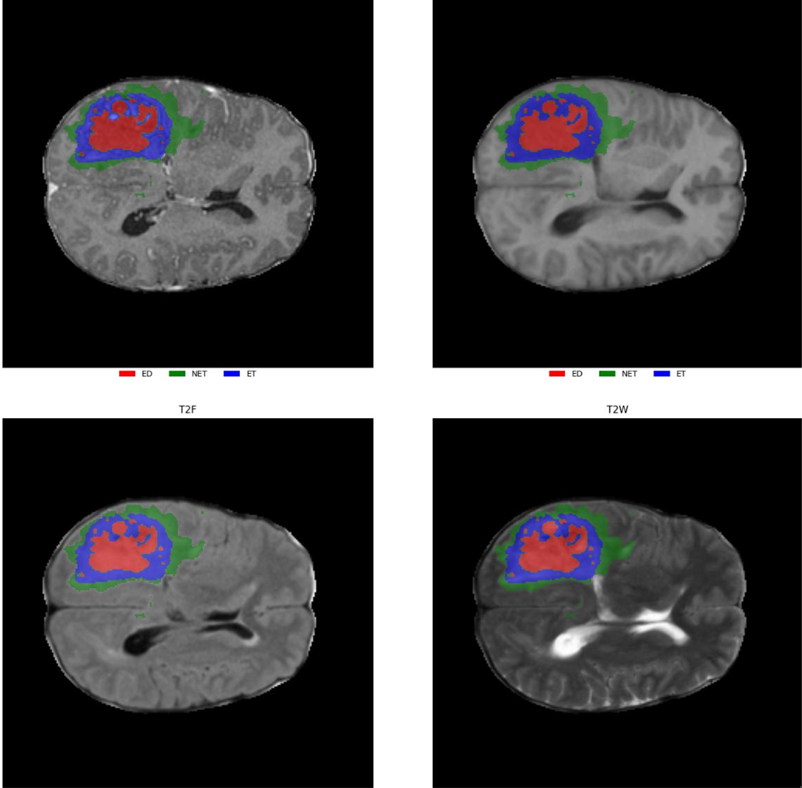
BraTS 2024 adult glioma post-treatment challenge
Objective:
Develop automated segmentation models for post-treatment gliomas.
Dataset:
includes multi-modal MRI images with glioma annotations.
Post-treatment focus:
Distinguishing recurrence from treatment effects.

Slide 13
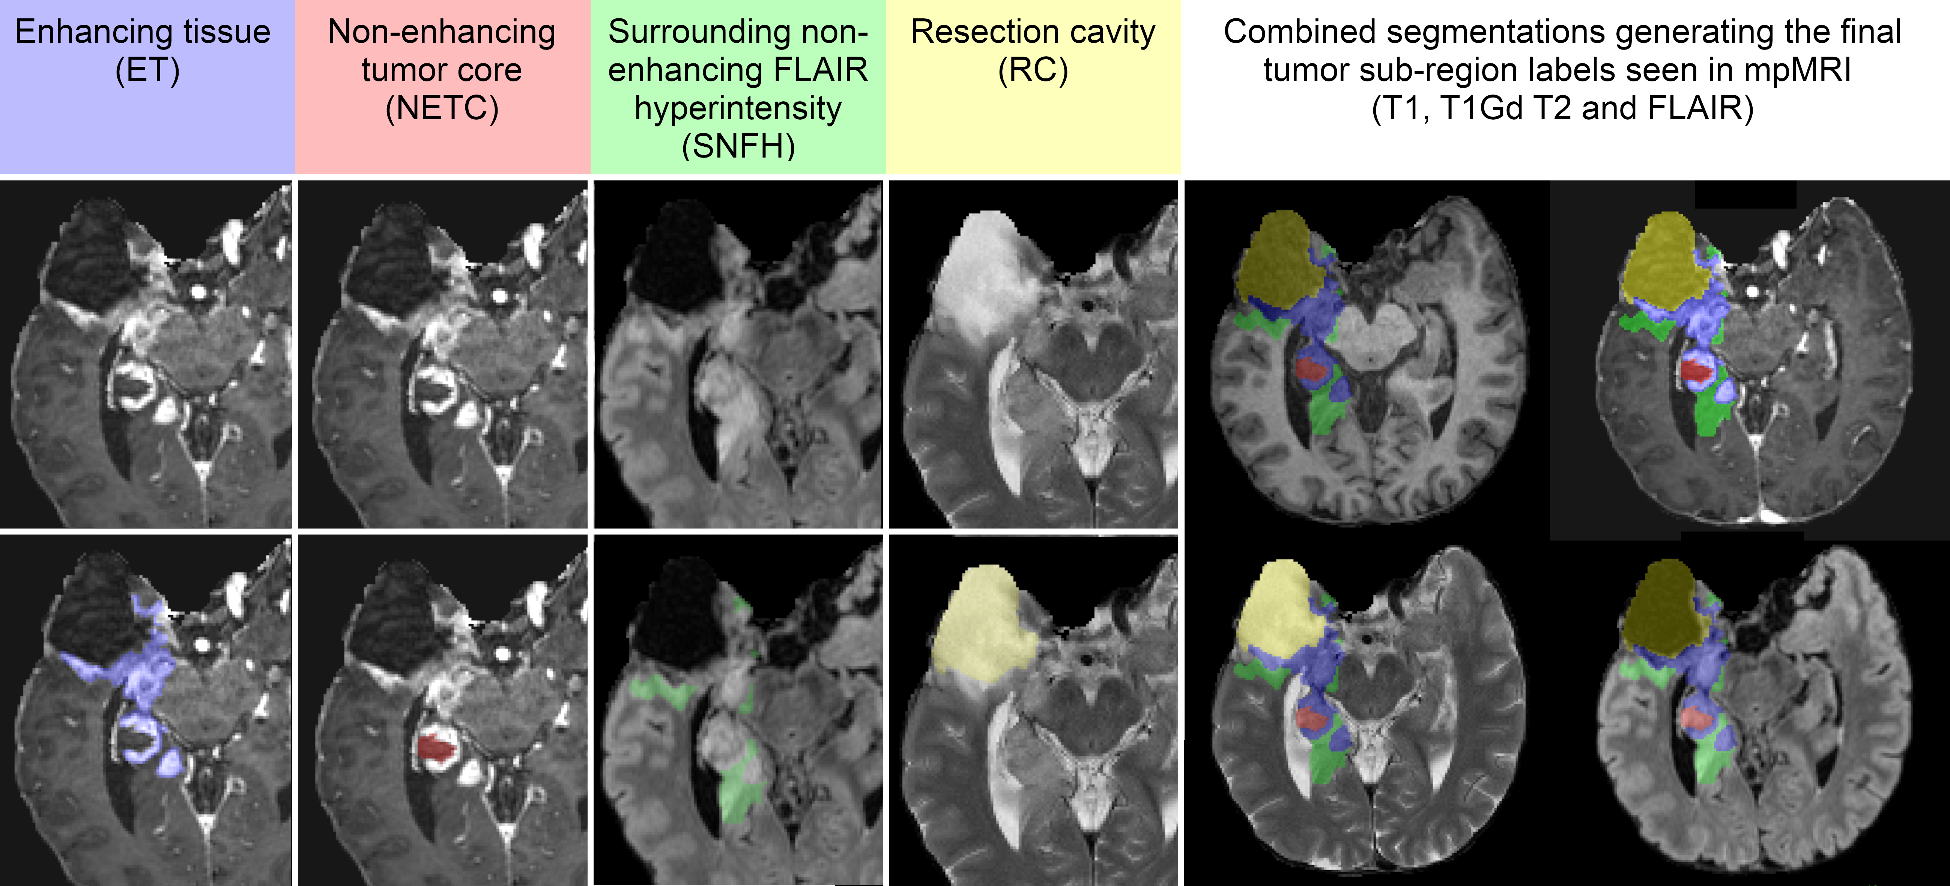
Distinguishing tumor subregions

Slide 14
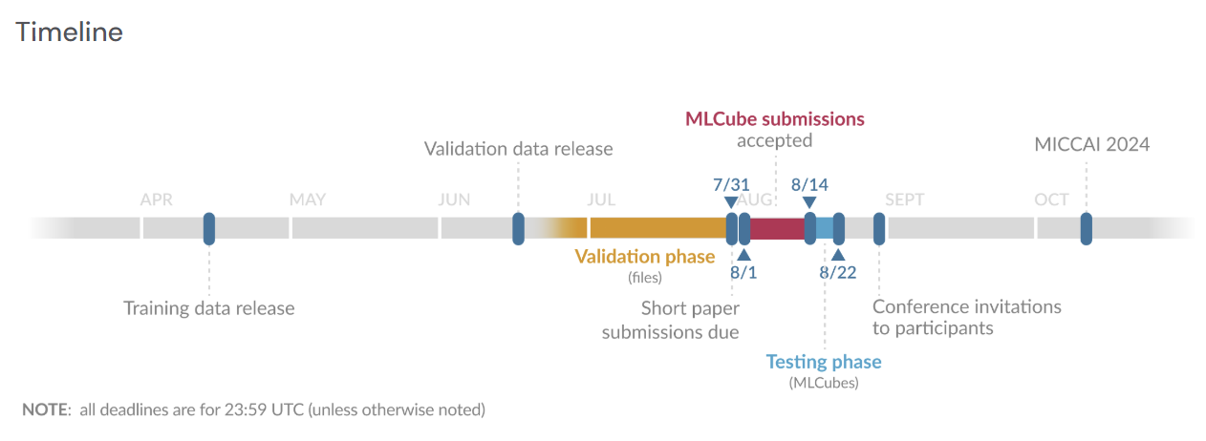
timeline

Slide 15
Dataset preprocessing & description

Slide 16
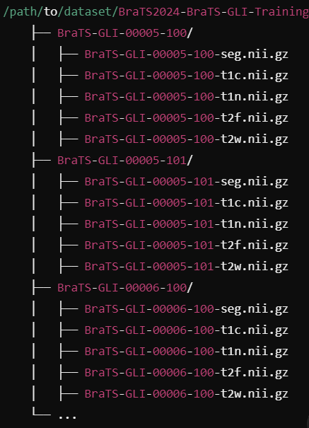
Brief description
Training and validation datasets with multi-timepoint MRI scans.
Ground truth only provided for the training set; validation used as test set.
Variability in the number of timepoints per patient (1 to 10).

Slide 17
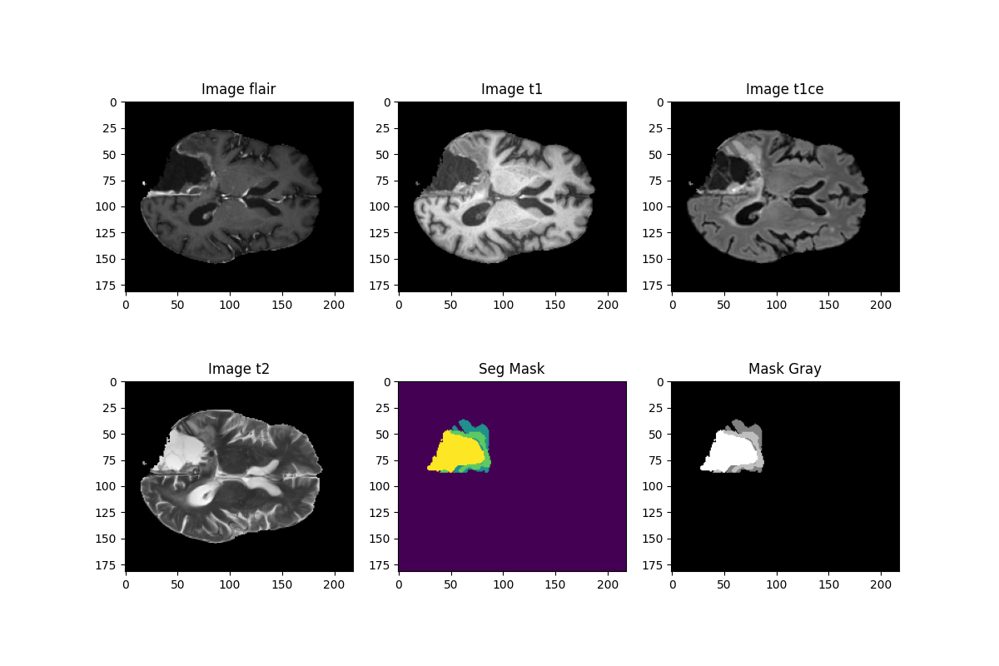

Slide 18
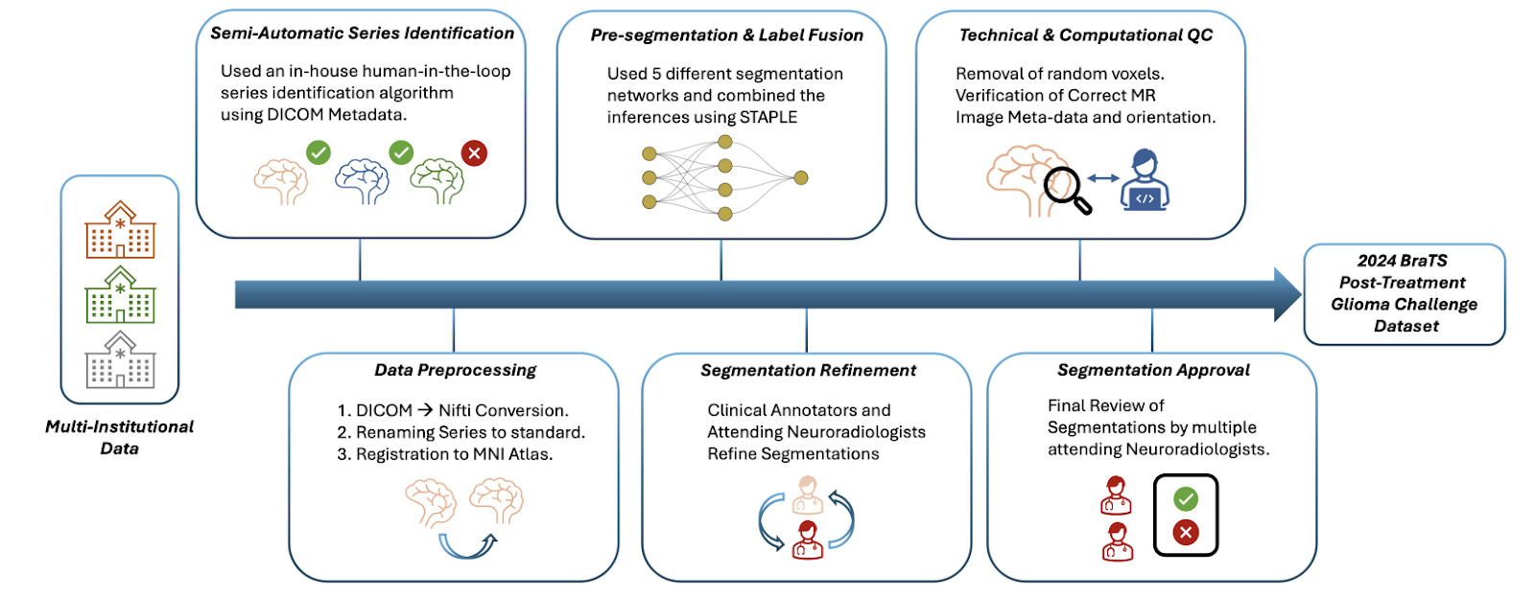
Data Preprocessing & Splitting strategy
Preprocessing Steps:
By BraTS:
Skull stripping.
Co-registration of all sequences.
Resampling to uniform spacing (182×218×182).
By myself:
Normalization (z-score)

Slide 19
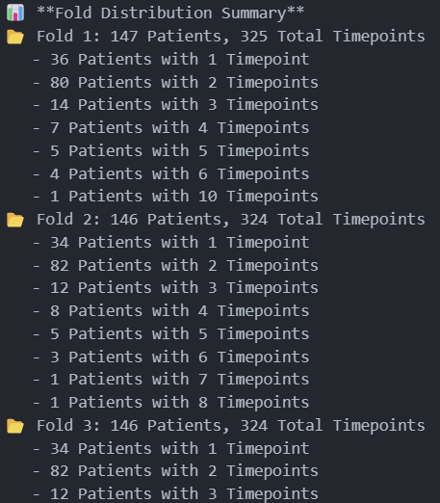
Data Preprocessing & Splitting strategy
Data Splitting:
Splitting strategy for 5-fold cross-validation ensuring patient-wise distribution.
.
.
.

Slide 20
3D u-net approach

Slide 21
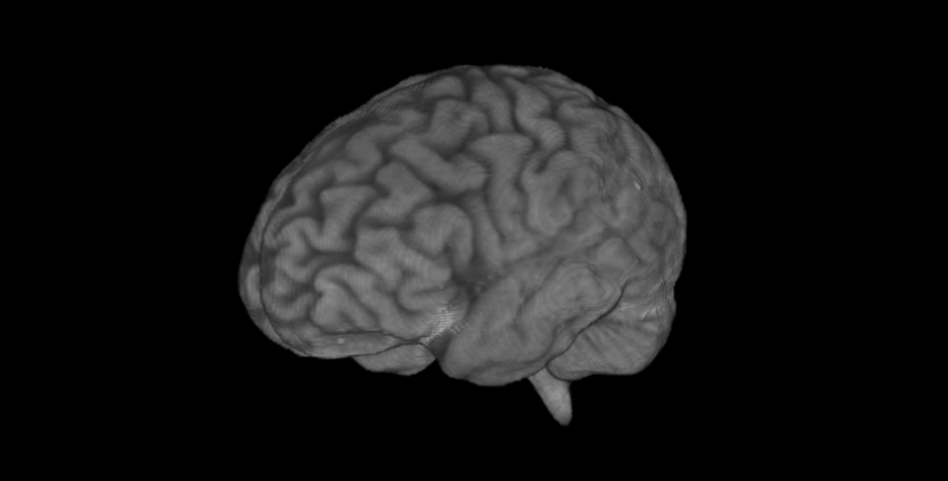
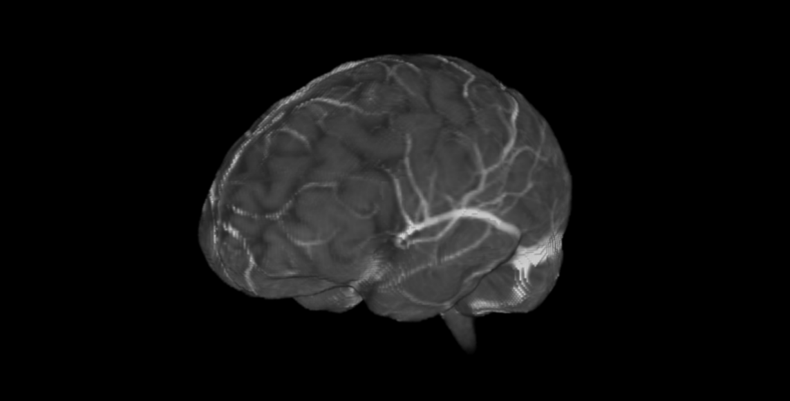
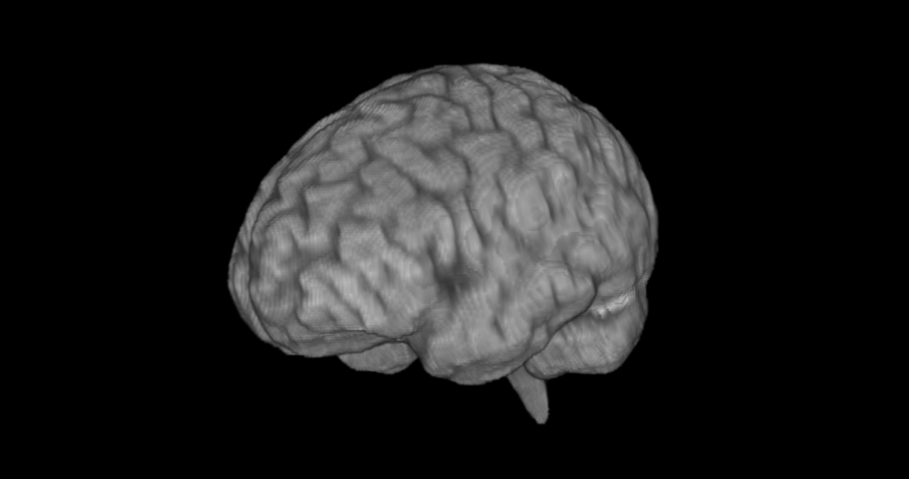
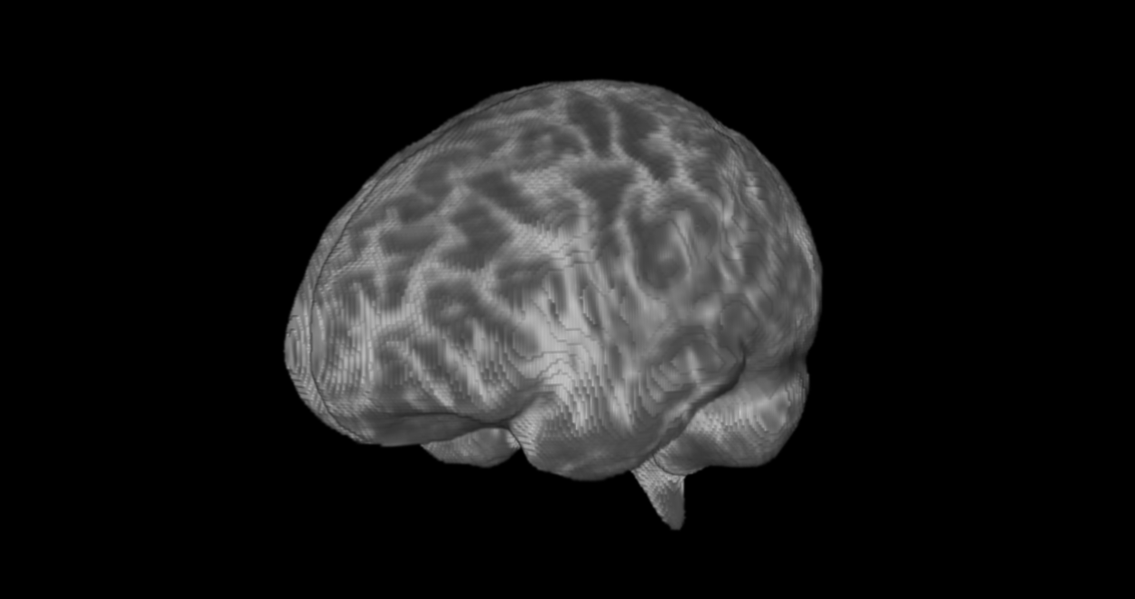
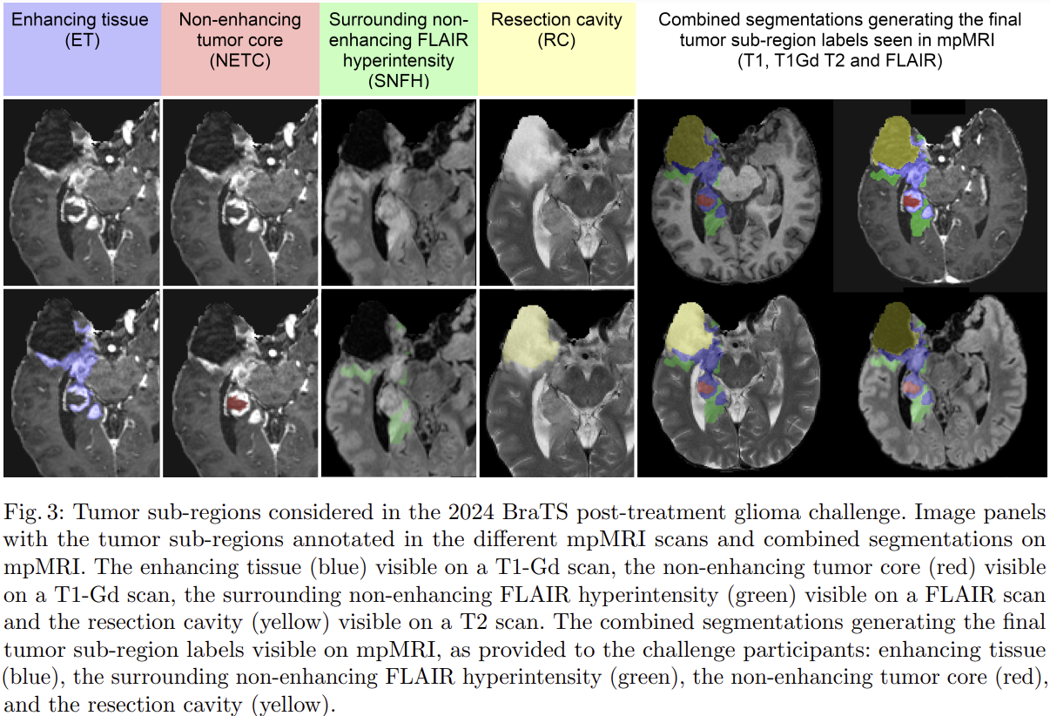
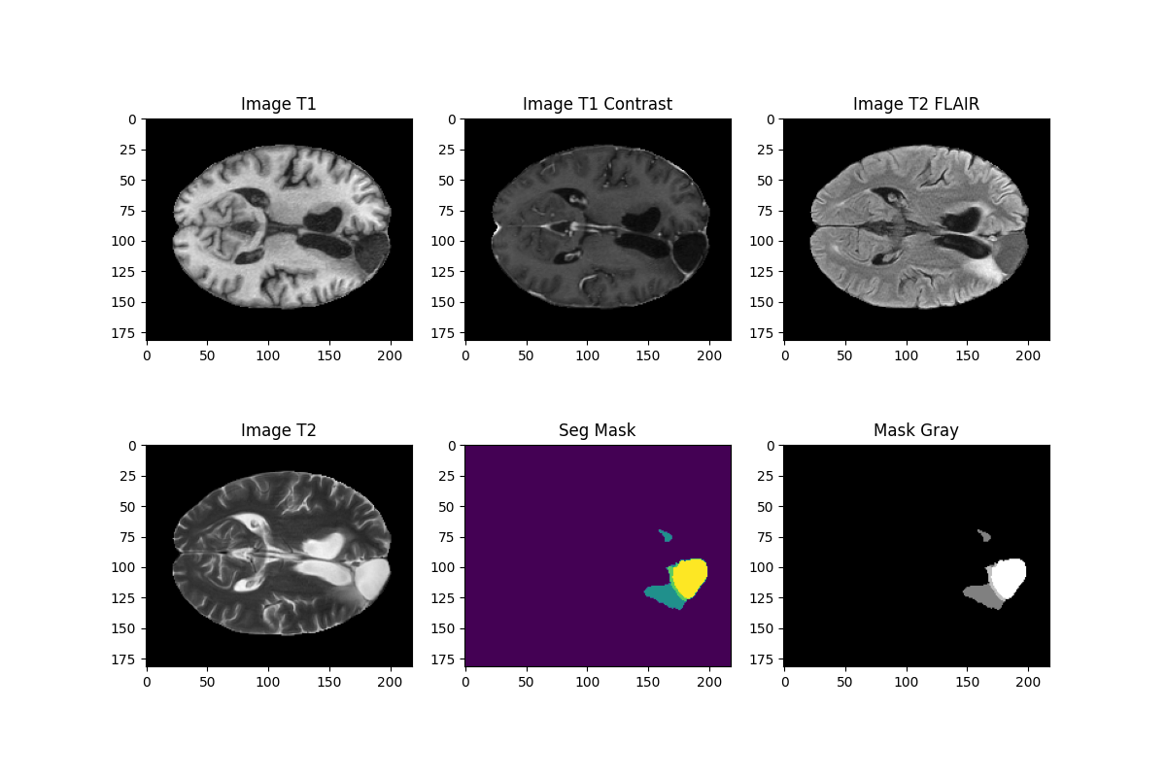
Monai-based 3D U-Net for Segmentation
**FLAIR: Fluid Attenuated Inversion Recovery
3D U-Net based pipeline for BraTS 2024 Post-treatment Glioma Dataset
MRI Scans
Enhancing Tissue
(ET)
Non-Enhancing Tumor Core (NETC)
Surrounding Non-enhancing FLAIR Hyperintensity (SNFH)
Resection Cavity
(RC)
Targets
3D-Segmented Tumor Subregions
(ET & NETC) and Post-Treatment Changes
(SNFH & RC)
T1-weighted
Post-contrast T1-weighted
T2 FLAIR
T2-weighted
Visualization of segmentation labels in 2D slices, indicating the different regions
Patch Extraction
Segmentation Model
Patchwise Prediction
Result
3D U-Net

Slide 22
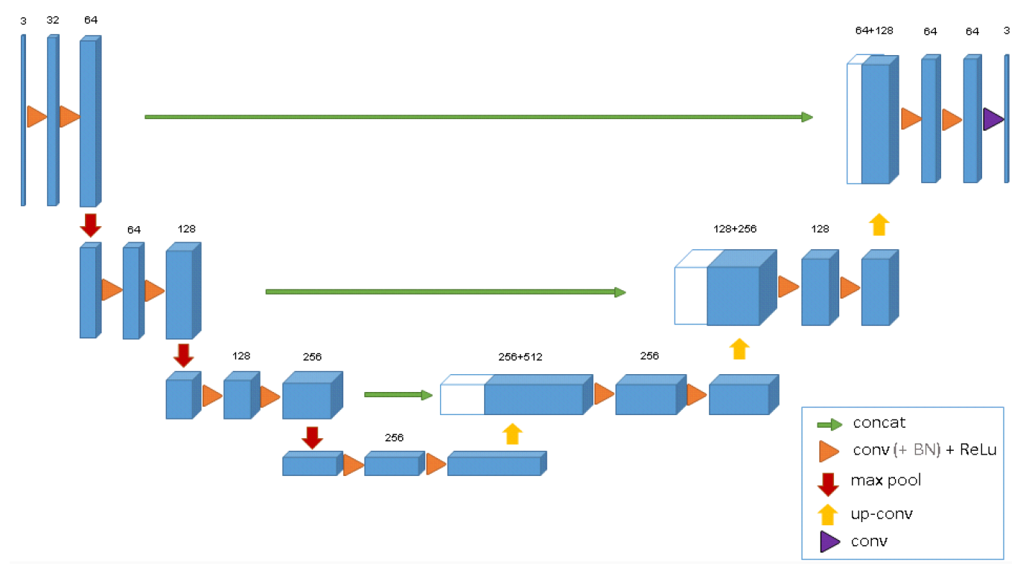
Modified 3D U-Net for Segmentation
Modify 3D U-Net model provided by MONAI
Patch-Based Training:
Patch size = (128,128,128).
Data Augmentation:
Random flipping, rotation, intensity shifts.
Loss Function:
Dice + Cross-Entropy Loss.
Optimizer:
Adam with learning rate scheduling.

Slide 23
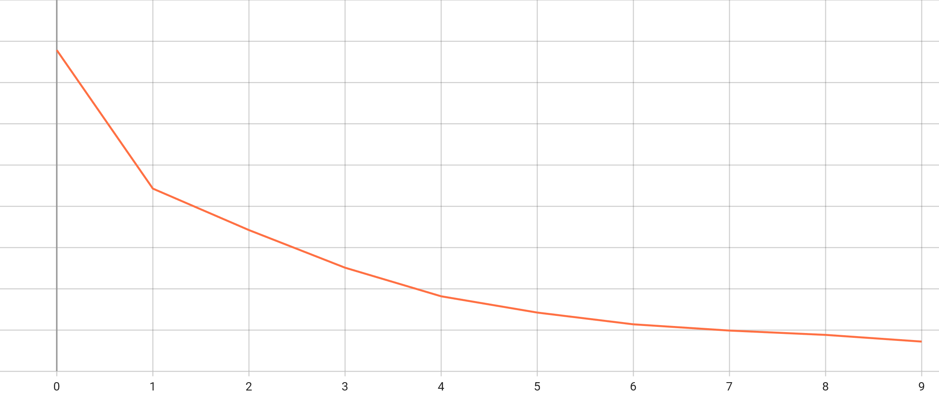
Model training & inference
One fold trained for 10 epochs (due to limitation in time & hardware)
Training loss showed decreasing tendency.
Total Train Loss

Slide 24
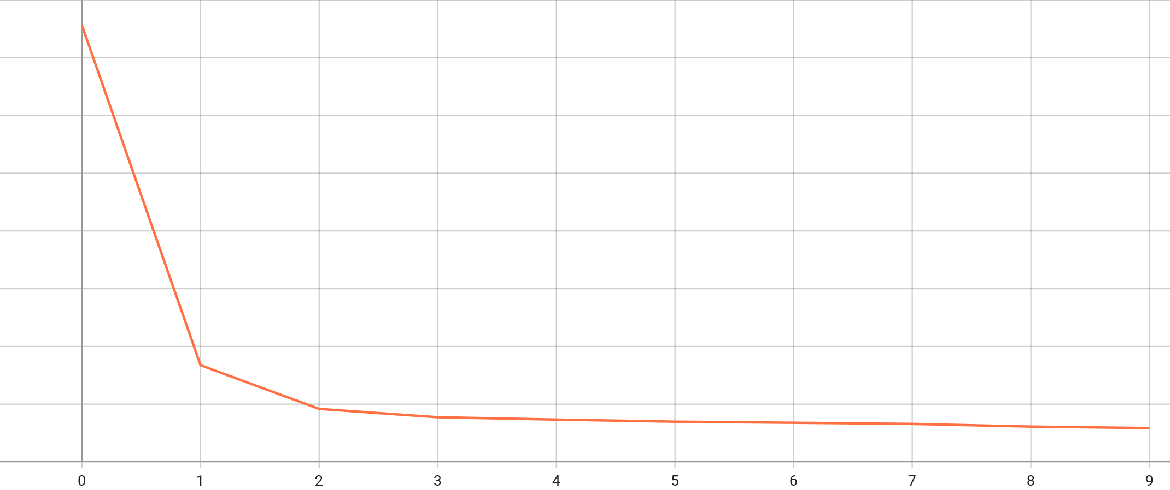
Cross-entropy loss

Slide 25
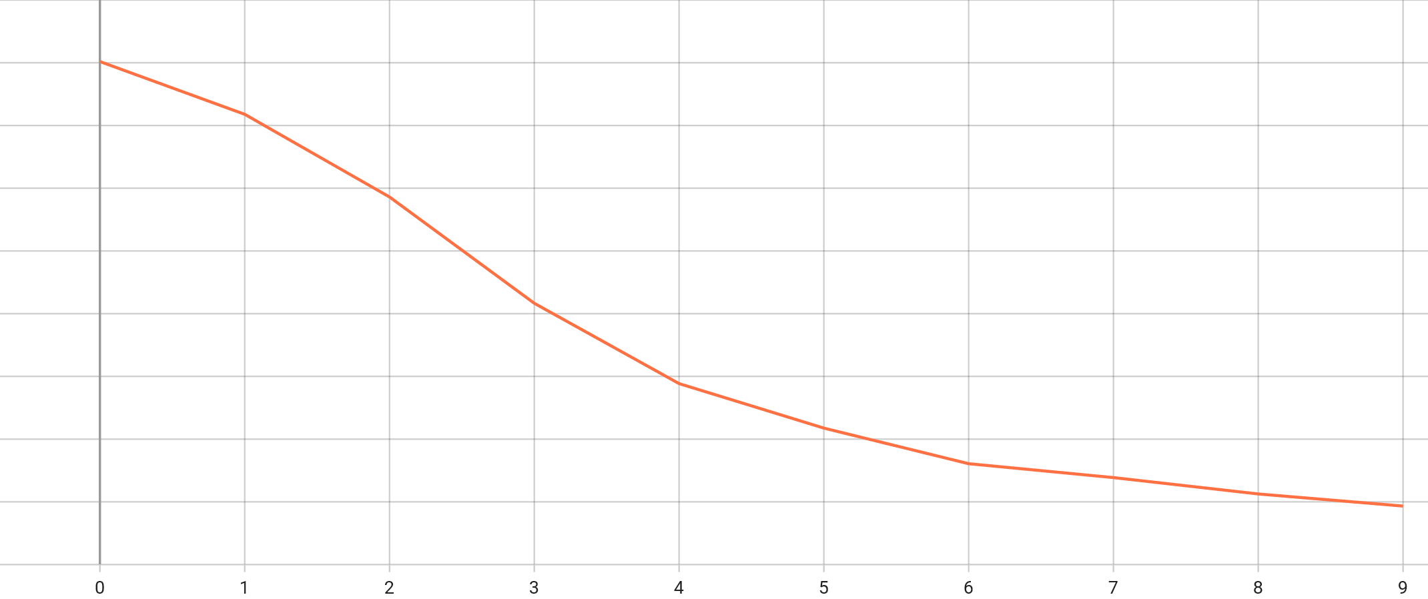
Dice similarity coefficient loss

Slide 26
Challenge winner’s approach: synthetic data augmentation

Slide 27
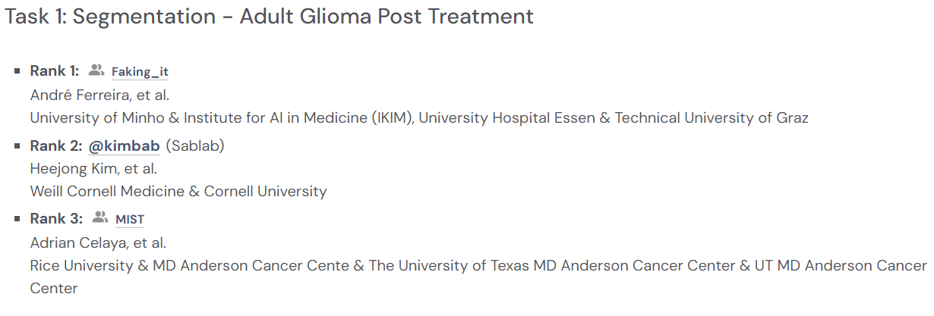
Winners of the challenge
[ The First-Place Solution ]
Approach:
Hybrid deep learning models with synthetic data augmentation.
Models Used:
nnU-Net (baseline framework).
Swin UNETR (transformer-based segmentation).
MedNeXt (convolutional alternative).

Slide 28
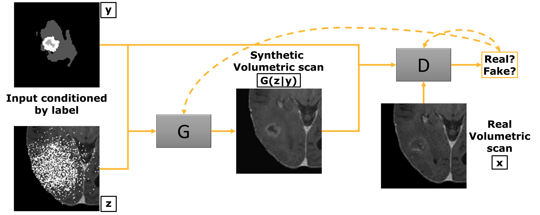
Synthetic Data Augmentation with Generative Adversarial Networks (GANs)
GliGAN Framework
Purpose:
Augments training data to enhance model generalization.
Implementation:
Uses GANs to synthesize realistic tumor samples.
Training Process:
Generates synthetic tumors for T1, T1Gd, T2, and FLAIR sequences.
Label generation with adversarial learning.

Slide 29
Results & visualization

Slide 30
Evaluation metrics: Dice & Hd95
Dice Score:
Measure of overlap between predicted and true segments.
HD95 (Hausdorff distance 95):
Measures the maximum boundary error.

Slide 31
Evaluation metrics: Dice & Hd95
Dice Score ↑ | ET | NETC | SNFH | RC
3D U-Net | 0.9248 | 0.0112 | 0.9474 | 0.8495
Winner | 0.9738 | 0.0905 | 0.9831 | 0.9378
Hausdorff Distance 95% ↓ | ET | NETC | SNFH | RC
3D U-Net | 1.4142 | 31.064 | 1.4142 | 5.0990
Winner | 1.0000 | 39.810 | 1.0000 | 1.0000
Tables comparing dice scores and Hausdorff distance at 95th percentile between the challenge winner’s model and 3D U-Net model for each lesion type.

Slide 32
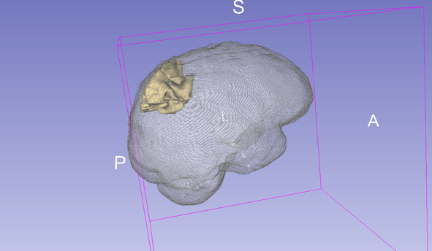
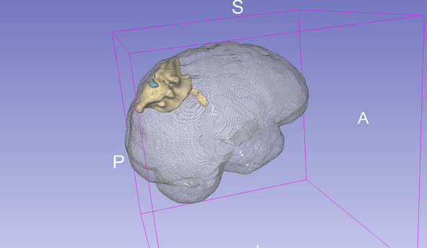
The winner’s algorithm prediction
Used 3D Slicer (medical image tool) to generate this.
Ground Truth Segmentation Masks
First Winner’s Predicted Segmentation Masks

Slide 33
Future works & summary of learning

Slide 34
Future work: enhancements & next steps
Next steps:
Inference on all validating data provided by BraTS for both first winner’s algorithm & my model
Train on all folds
increase epochs
explore nnUNet (which most challenge participants used as baseline)

Slide 35
Future work: enhancements & next steps
Possible Enhancement:
Ensemble methods and exploring different architectures
Build an interactive web-based visualization tool for segmentation visualization

Slide 36
Summary of learnings
Key takeaways:
Post-treatment Gliomas segmentation
3D U-Net auto segmentation workflow
Volume rendering & visualization techcniques using 3D Slicer

Slide 37


